Slide 1
Understanding Organization
Presented By:
Shahek Khan
Abida Batool
Samran Saleem
Maira Kanwal

Slide 2
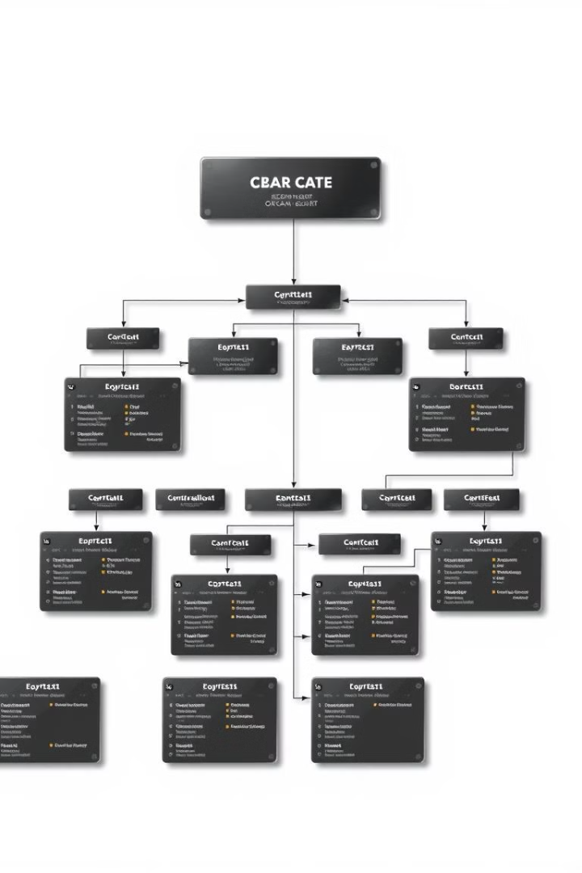
Understanding Business Organization
This presentation provides a comprehensive overview of business organization, examining both traditional and contemporary perspectives. We'll delve into the structure, processes, and strategies that define successful organizations.

Slide 3
The Traditional View of an Organization's Structure
Hierarchical Structure
Functional Departments
The traditional view emphasizes a clear chain of command, with authority flowing from top to bottom.
Organizations are typically divided into departments, each specializing in a specific area.

Slide 4
The Systems View of an Organization
Interconnected Processes
Process Flow
The systems view focuses on how different parts of an organization work together as a system.
It emphasizes the flow of information and resources through various processes.

Slide 5
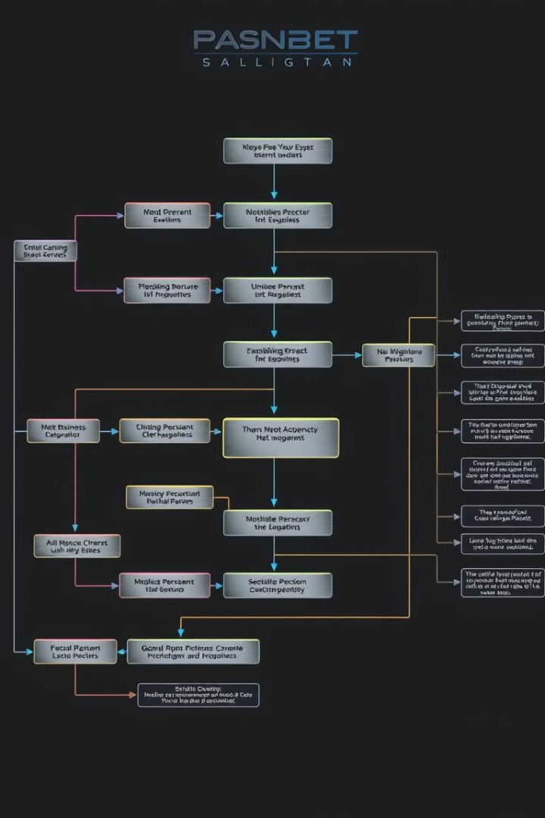
Business Process Management (BPM): Strategy and the Enterprise
Alignment with Strategy
Process Optimization
BPM ensures business processes support the organization's strategic goals.
BPM identifies and eliminates inefficiencies, improving speed and quality.
Continuous Improvement
Technology Integration
BPM fosters a culture of ongoing analysis and enhancement of processes.
BPM leverages technology to automate and streamline processes, enhancing efficiency and effectiveness.

Slide 6
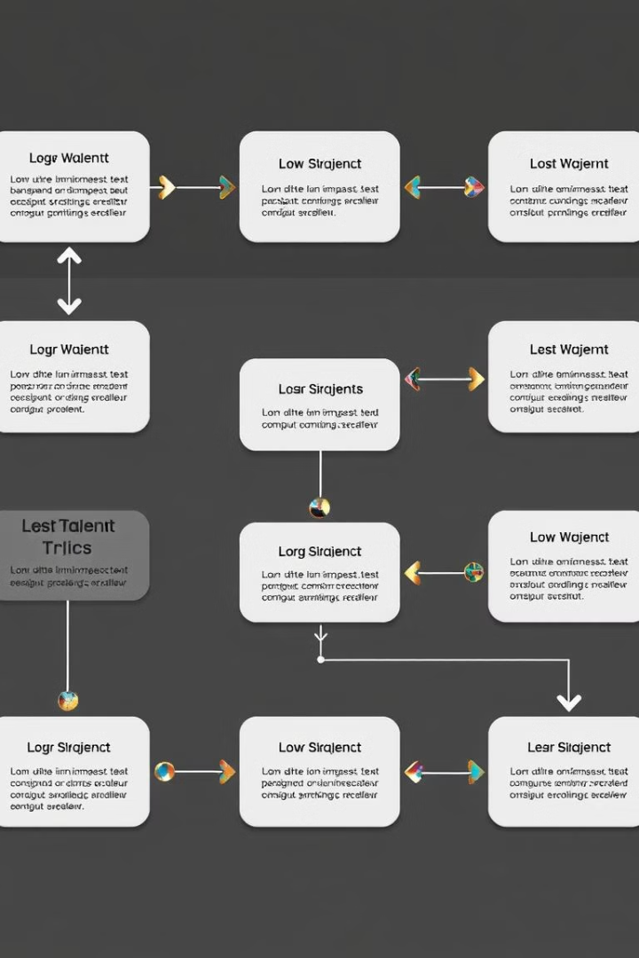
Modeling and Diagramming Business Processes
1
Process Identification
Identify and define the key processes within the organization.
2
Process Mapping
Create visual representations of the process flow, including steps and decision points.
3
Process Analysis
Evaluate process efficiency, identify bottlenecks, and areas for improvement.
4
Process Documentation
Document the process in a clear and concise manner, including procedures and guidelines.

Slide 7
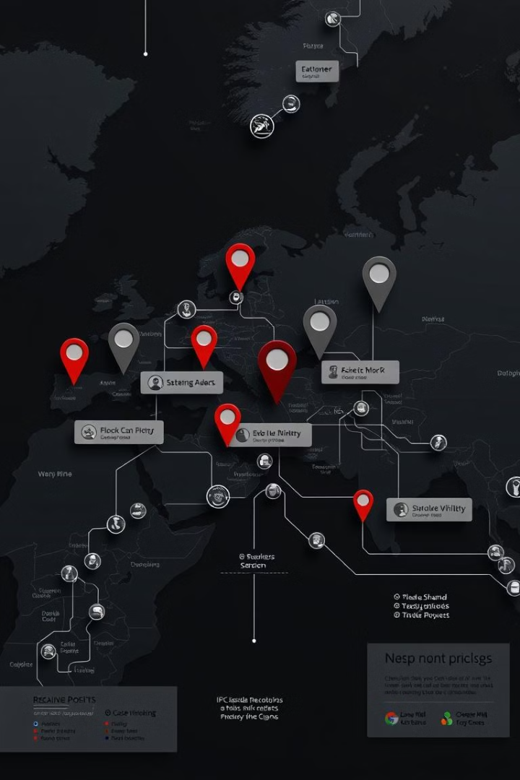



Identifying and Mapping Key Business Processes
Process Identification
Start by identifying the key processes that drive the organization's success. These are the core activities that contribute to the overall goals and objectives.
Process Mapping
Create a visual representation of the process flow, documenting each step, decision point, and interaction between different departments.
Process Analysis
Analyze the mapped processes to identify bottlenecks, inefficiencies, and areas for improvement. This helps understand how the process works and where it can be optimized.

Slide 8
Optimizing and Automating Business Processes
Process Analysis
1
Identify areas for improvement and potential automation.
Technology Selection
2
Choose the right tools and platforms to automate tasks.
Implementation
3
Implement automation solutions and integrate them with existing systems.
Continuous Monitoring
4
Track performance, identify issues, and make adjustments.

Slide 9




Aligning Business Processes with Organizational Strategy
Strategic Goals
1
Define the overall direction and objectives of the organization.
Process Design
2
Align processes with strategic objectives, ensuring they contribute to achieving goals.
Performance Measurement
3
Track process performance against strategic targets, making necessary adjustments.
Continuous Improvement
4
Regularly review and optimize processes to ensure alignment with evolving strategies.

Slide 10

Building a Culture of Continuous Process Improvement
1
2
Empowerment
Collaboration
Encourage employees to identify and propose process improvements.
Foster a culture of open communication and teamwork.
3
4
Feedback
Training
Regularly gather and act on feedback to refine processes.
Invest in training and development to enhance process skills.

Slide 11



Leveraging Technology to Enhance Business Processes
Automation
Cloud Computing
Analytics
Automate repetitive tasks, improving efficiency and freeing up staff for more strategic work.
Access data and applications from anywhere, enhancing collaboration and flexibility.
Gain insights from data, enabling informed decision-making and process optimization.

Slide 12
Thank you!

Slide 13
Thank you!

